Slide 1


Impact of Science Conference the Parallel Session on:
Mass Media & Communication
25th June, 2021

Slide 2


Impact of Science
23-25 June, 2021
Paul Manners (Chair) : Founding Director, National Co-ordinating Centre for public engagement, UK
Ger Hanley: Founder Write Fund, Republic of Ireland
Dariusz Aksamit: Head of Council of March for Science Foundation, Poland
Marina Joubert: Senior Researcher, Stellenbosch University, South Africa
Overview of the Speakers
#IOS21

Slide 3
Impact of Science
23-25 June, 2021
Ger Hanley
Founder Write Fund, Republic of Ireland
#IOS21

Slide 4

Is Science Communication Accessible?
And what does that mean in reality?
Ger Hanley

Slide 5
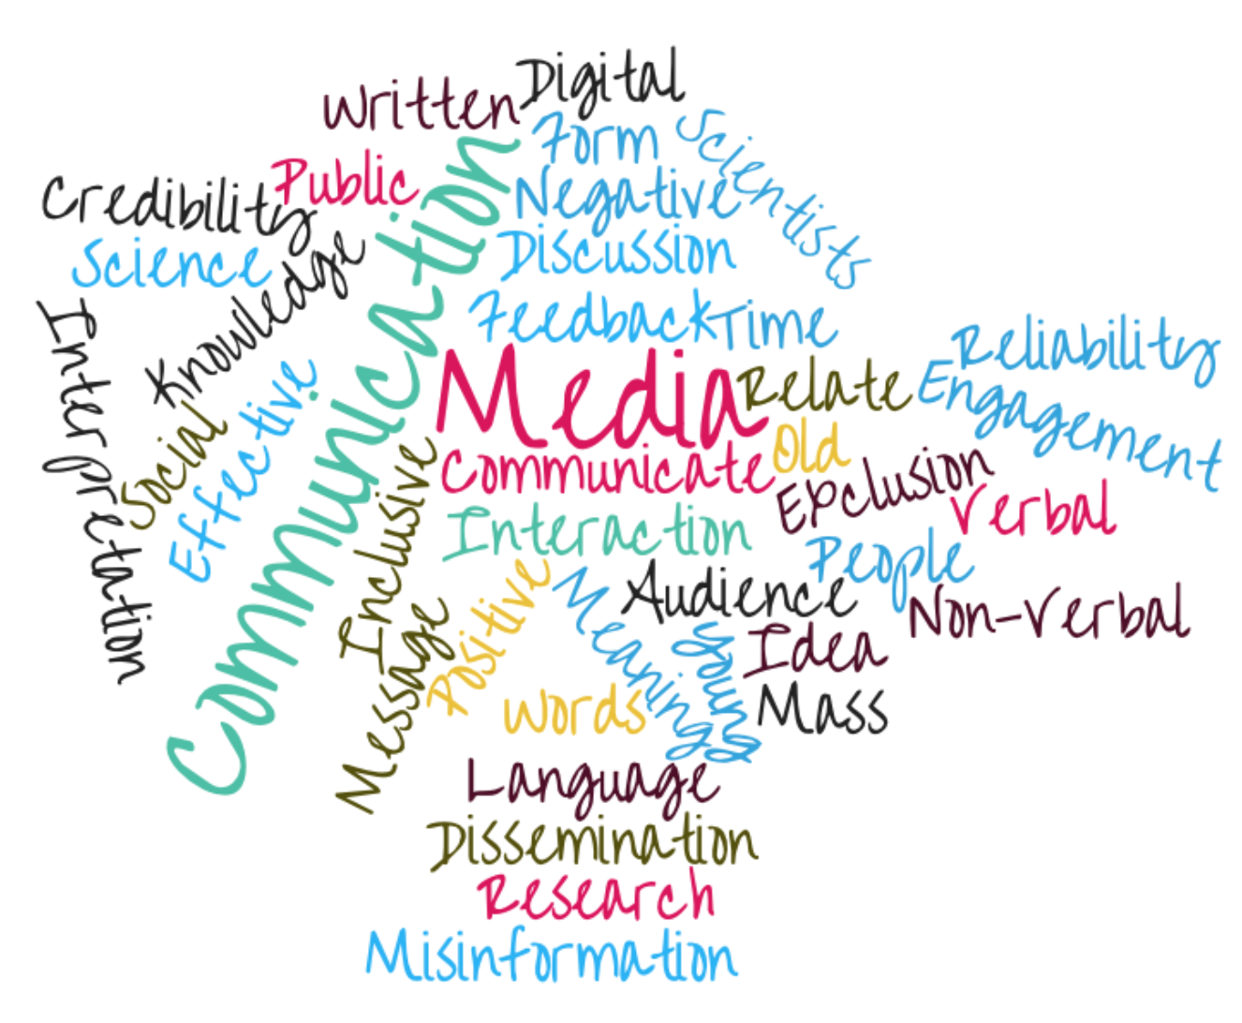
Science Communication

Slide 6

During COVID-19, science communication was never been more vital, drawing a new audience

Slide 7

Science held the missing piece of the puzzle.

Slide 8
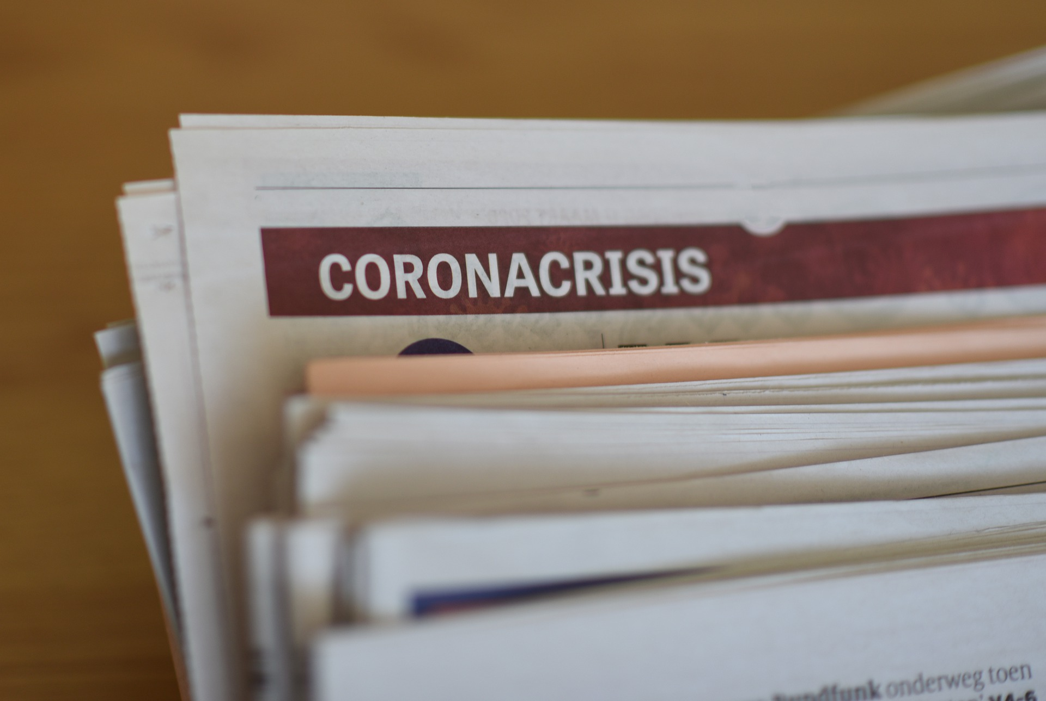
During COVID-19, national scientists and experts became the ‘new’ science and health journalists

Slide 9

Good Pandemic Science Communication
Clear
Transparent
Open
Rapid Reliable Information
Reached every corner of society via
  Print
  Radio
  TV
  Online

Slide 10
But was it accessible to all?

Slide 11
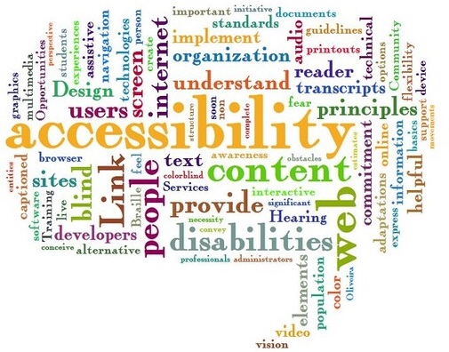

Accessibility

Slide 12

What accessibility actually means
Reach as many people as possible!
It is not a ‘one-size-fits-all’
It addresses barriers and provides a variety of ways for people to engage.

Slide 13

Leave No One Behind
Source: https://commons.wikimedia.org/wiki/File:Sustainable_Development_Goals.jpg
Notes:
Leave no one behind is the central, transformative promise of the 2030 Agenda for Sustainable Development and its Sustainable Development Goals (SDGs).
Source: https://unsdg.un.org/2030-agenda/universal-values/leave-no-one-behind

Slide 14

Inclusive Communication Needs Inclusive Design

Slide 15
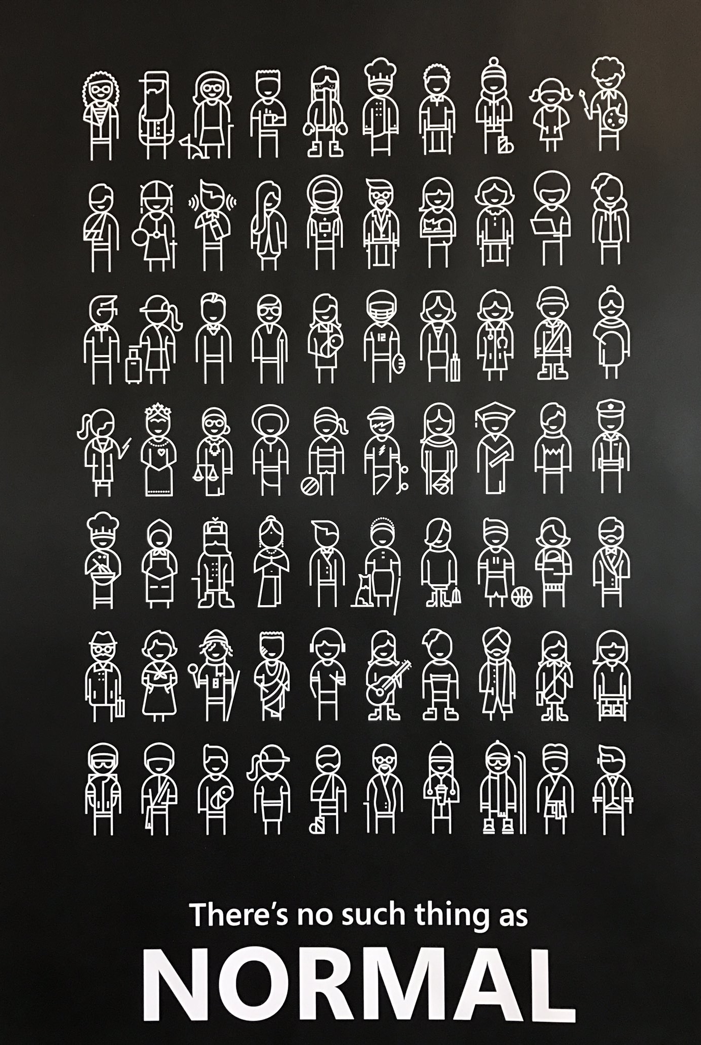
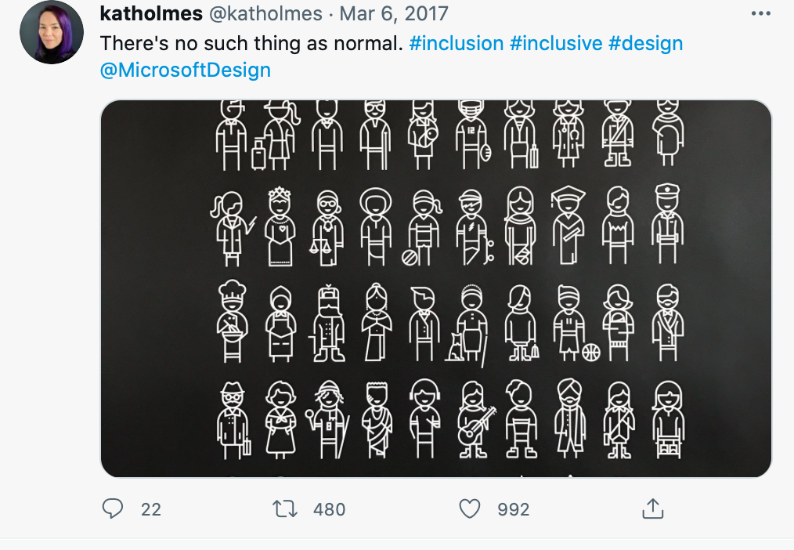
There’s no such thing as normal

Slide 16
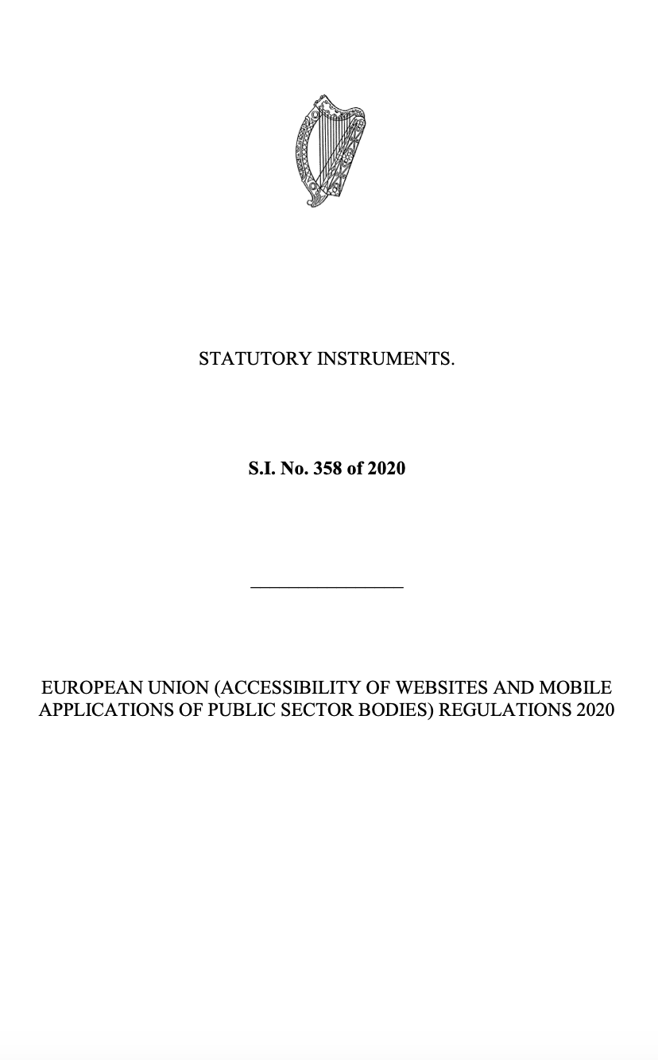
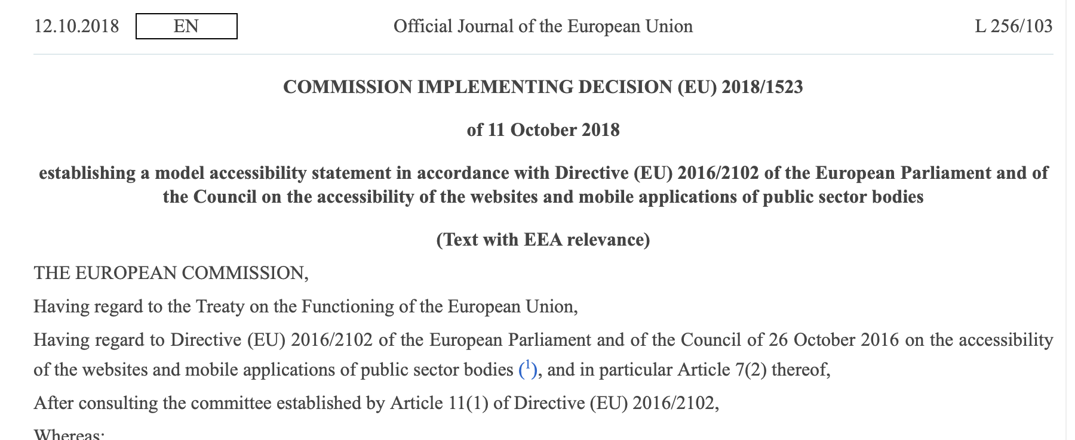
Legislation and Regulations

Slide 17
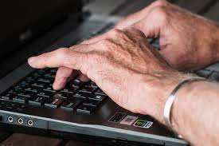
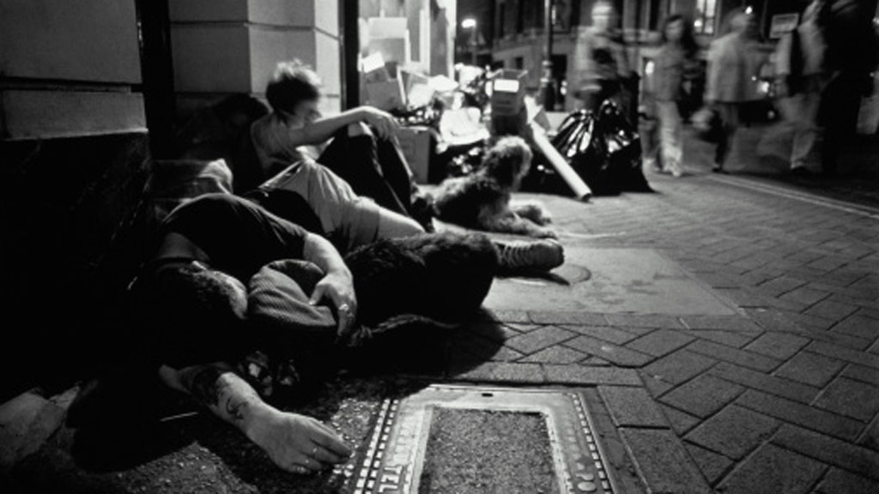
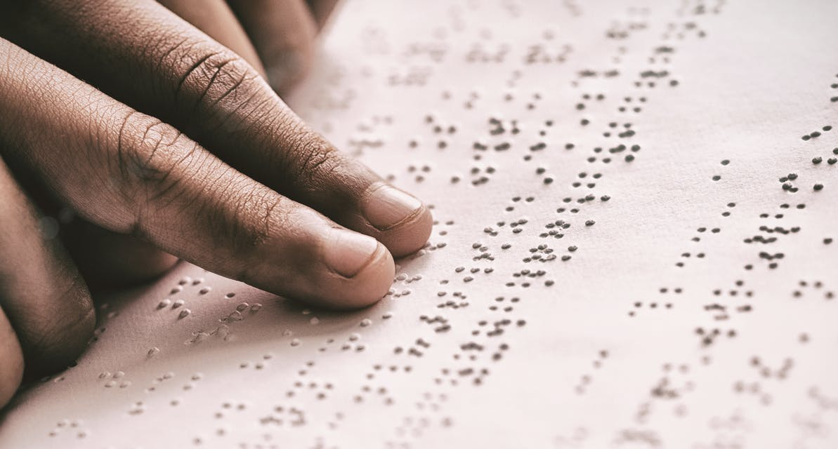
Inclusive Communication Recommendations
Consider digital literacy – old and young
  Outside the digital mainstream
    E.g. Young homeless, unemployed, seeking asylum
Consider disabilities and recognise they are a different ABILITY
Consider language
Consider mode
Consider Method

Slide 18
Impact of Science
23-25 June, 2021
Dariusz Aksamit
Head of Council of March for Science Foundation, Poland
#IOS21

Slide 19
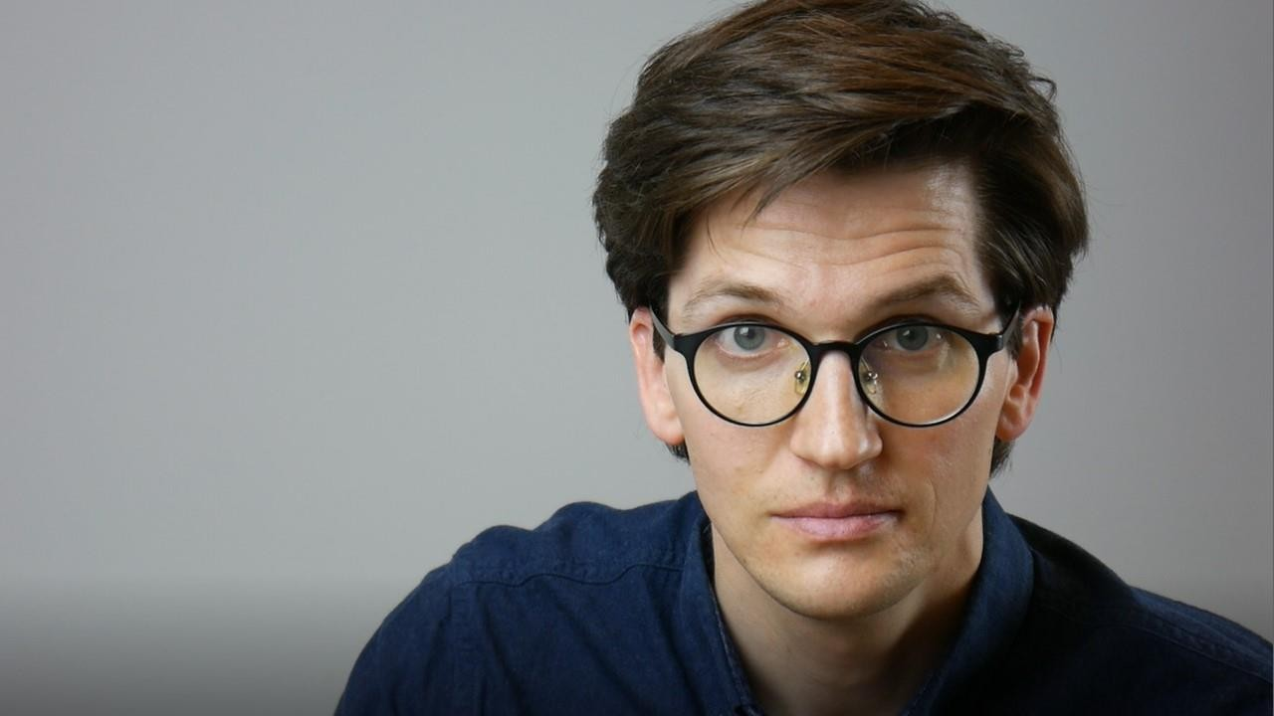
Battlefield: social media!
Dariusz Aksamit
March for Science Foundation www.aksamit.info
AESIS Impact of Science 2021

Slide 20
What does „war” have to do with
„science communication”
?

Slide 21

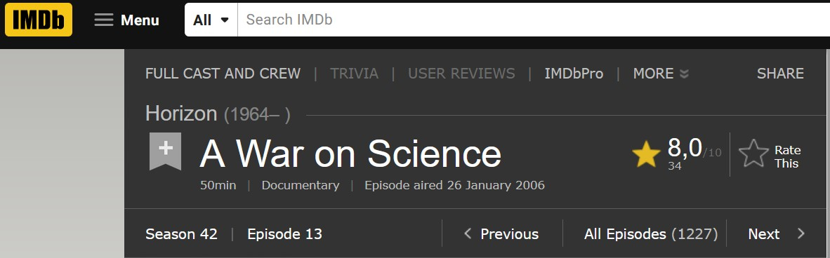
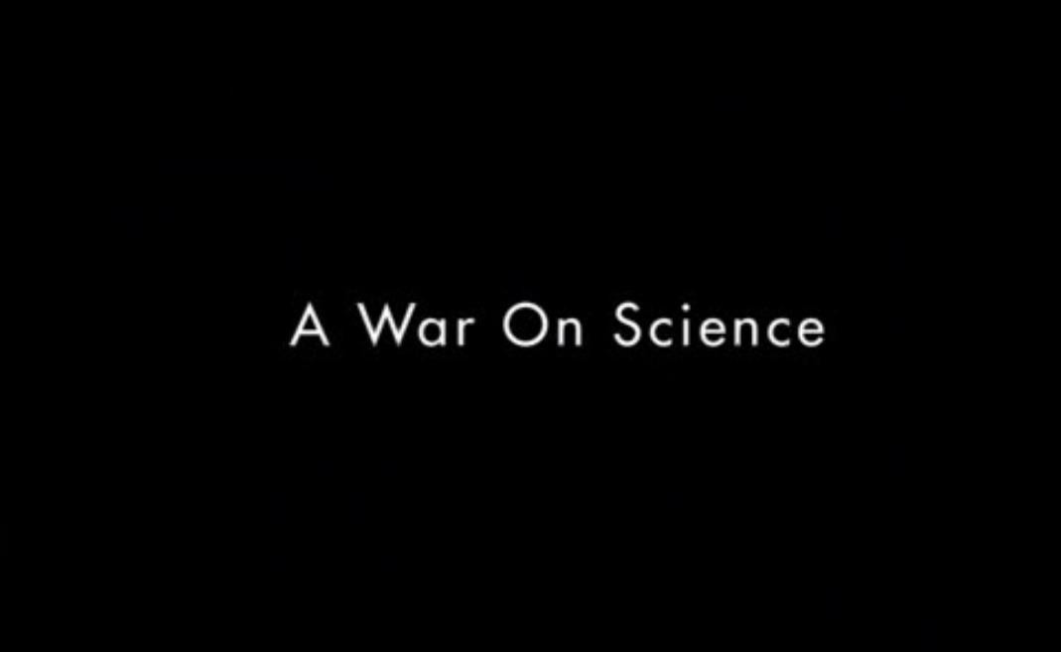

Slide 22

We have opposing sides and innocent civilians get hurt

Slide 23
We have opposing sides and innocent civilians get hurt
Not vaccinated?

Slide 24
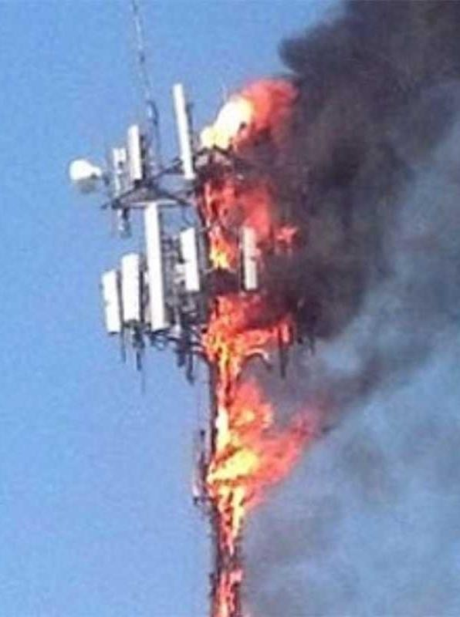
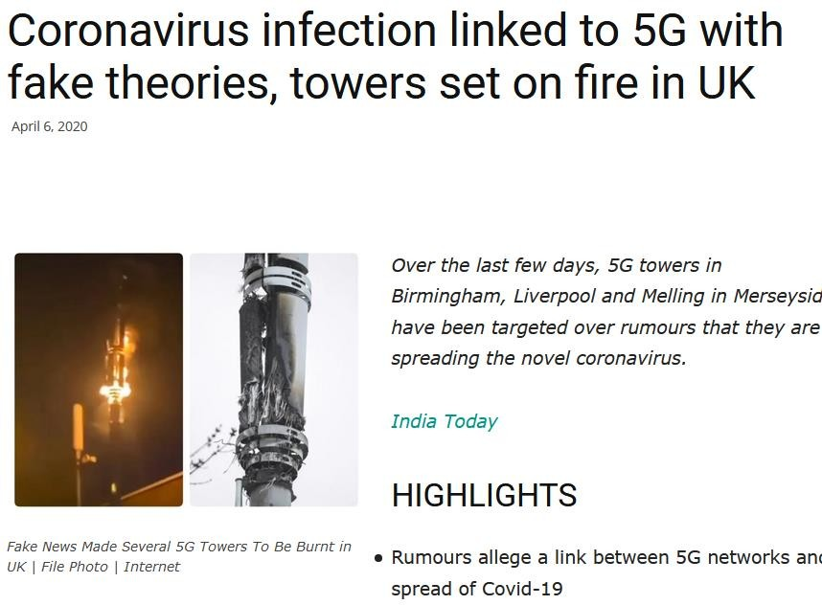

Slide 25
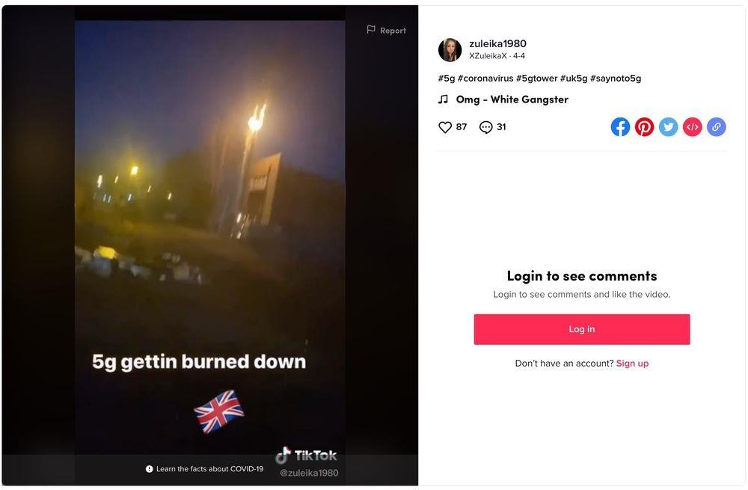
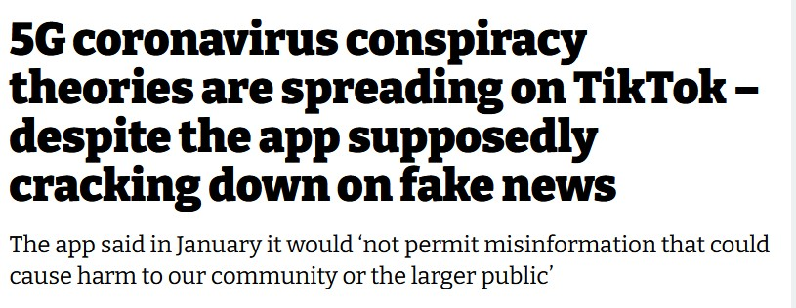

Slide 26
We have opposing sides and innocent civilians get hurt
And war is not only about a fight

Slide 27
We have opposing sides and innocent civilians get hurt
And war is not only about a fight
Training?
Logistics & technical suport?
Intelligence?

Slide 28
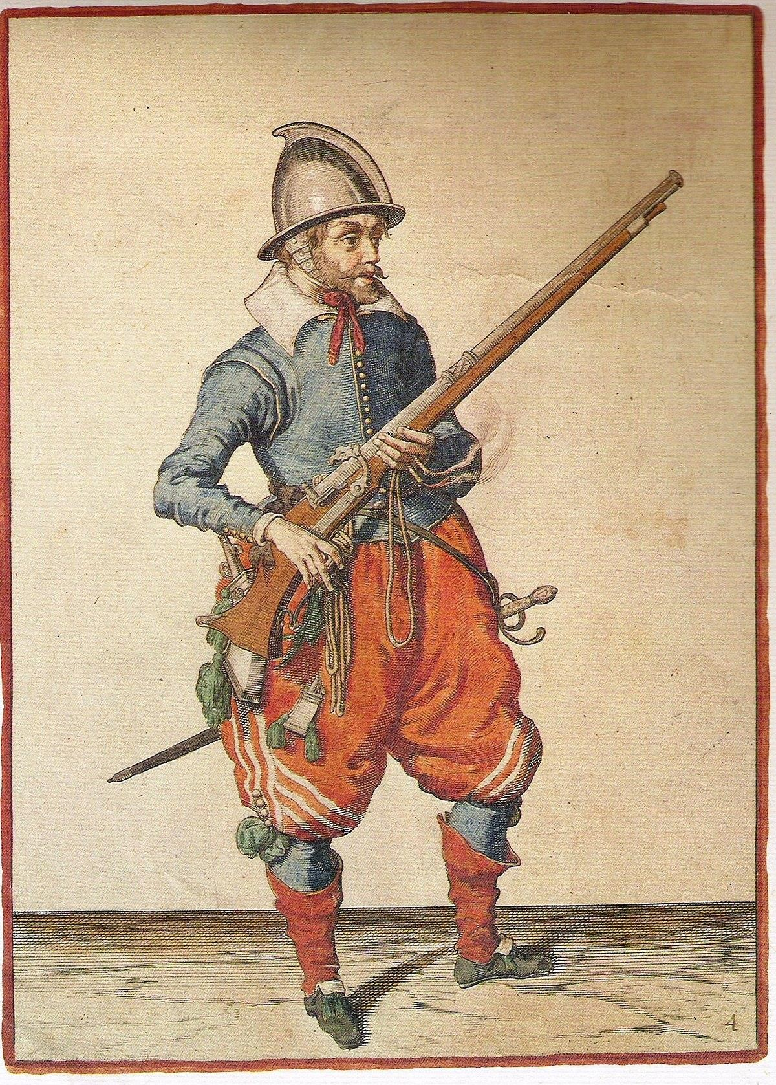
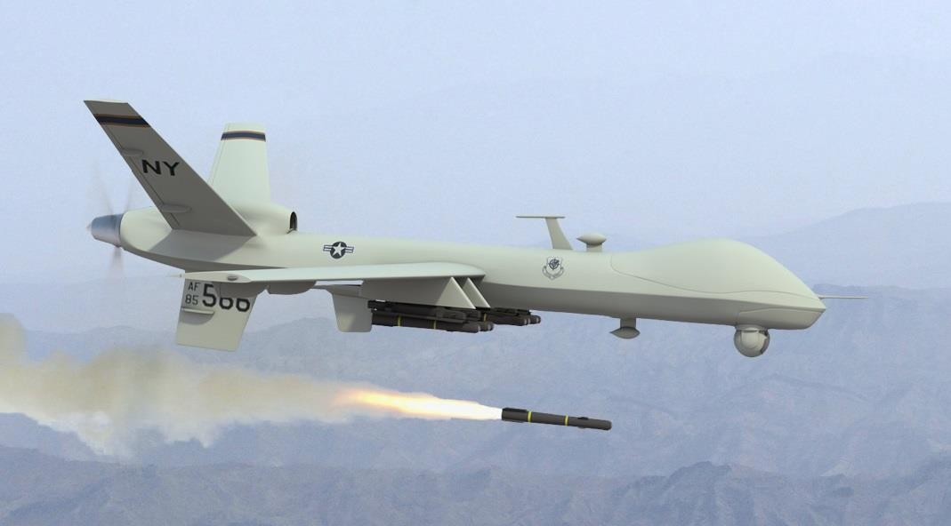
Without…
…Training?
…Logistics & technical suport?
…Intelligence?

Slide 29
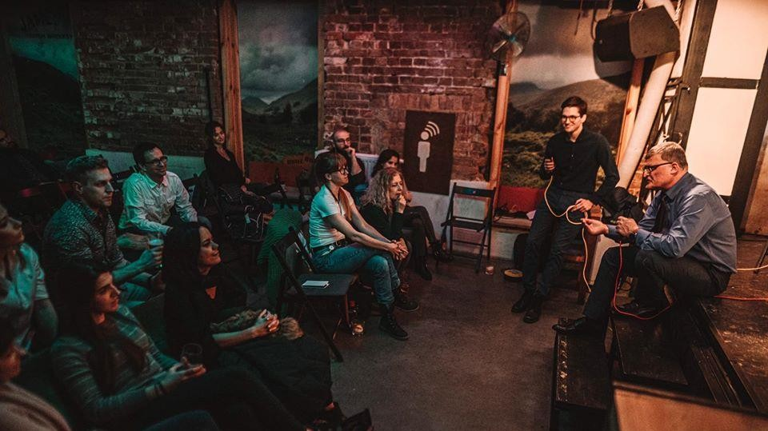

Training? 04.03.2020, day 0

Slide 30

Training? 04.03.2020, day 0

Slide 31

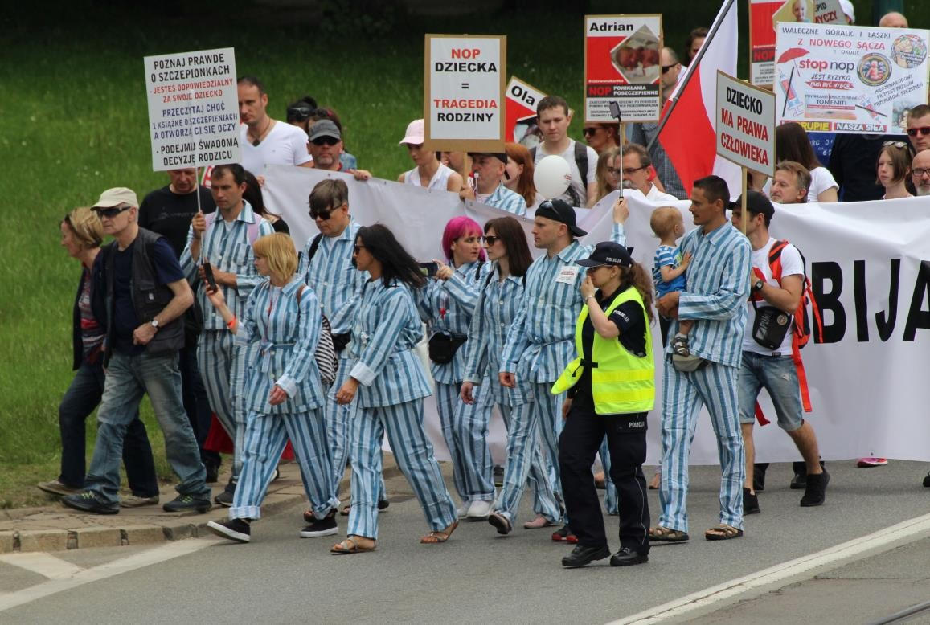
Intelligence?
Yes – like infiltration

Slide 32
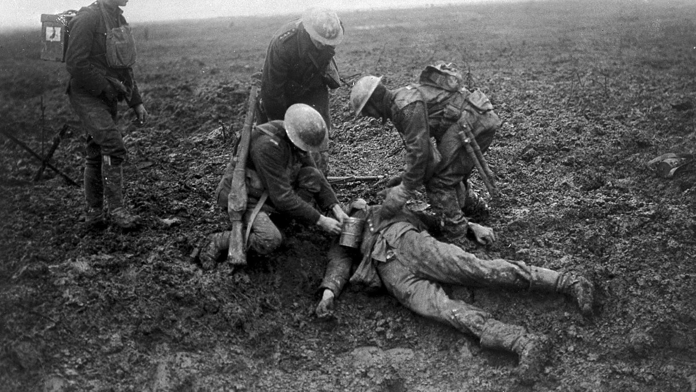
Yes, you can be harmed on a battlefield

Slide 33
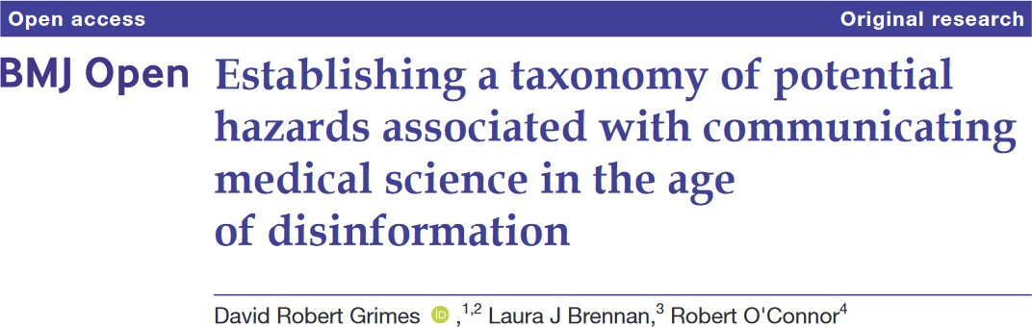
https://bmjopen.bmj.com/content/bmjopen/10/7/e035626.full.pdf

Slide 34
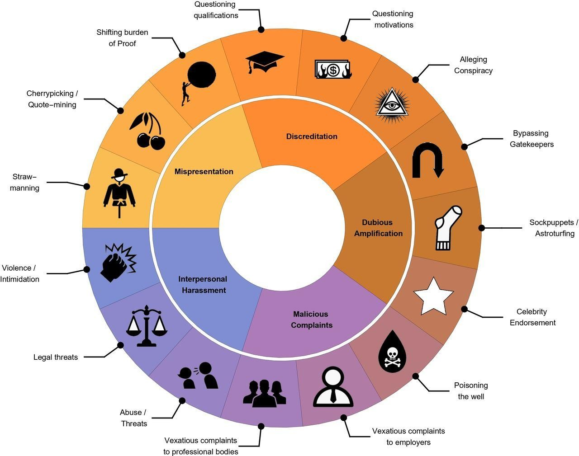
https://bmjopen.bmj.com/content/10/7/e035626

Slide 35
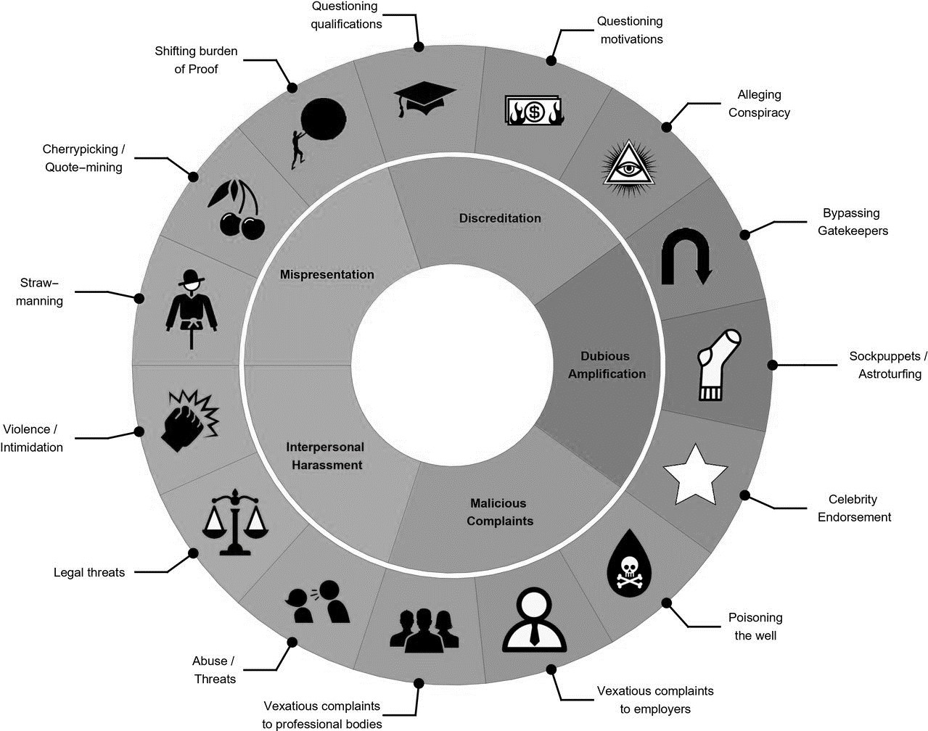
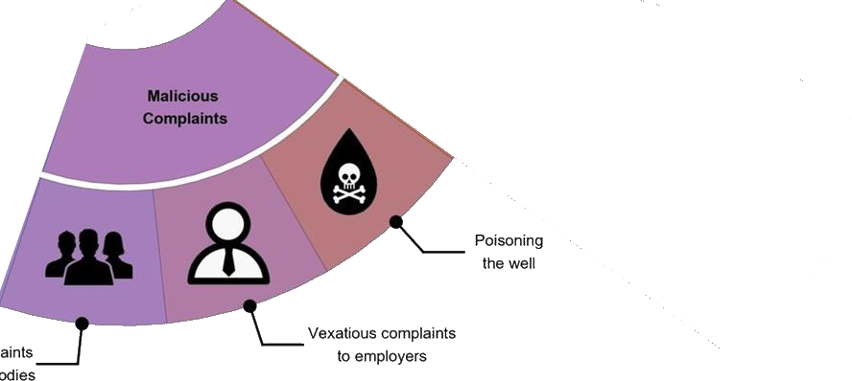
https://bmjopen.bmj.com/content/10/7/e035626

Slide 36
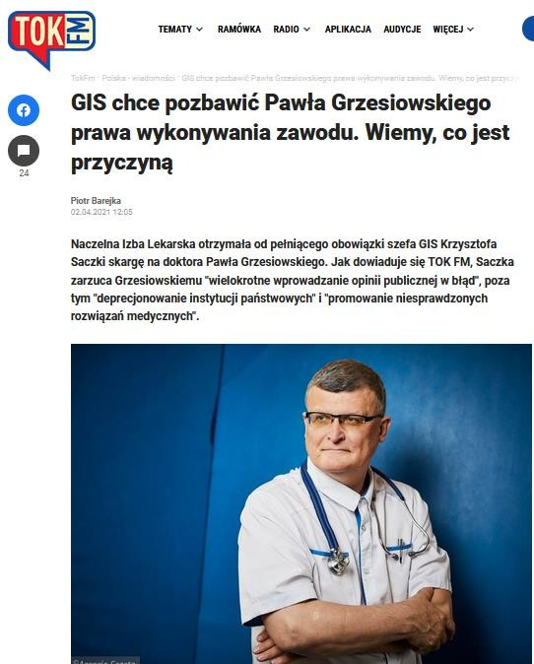
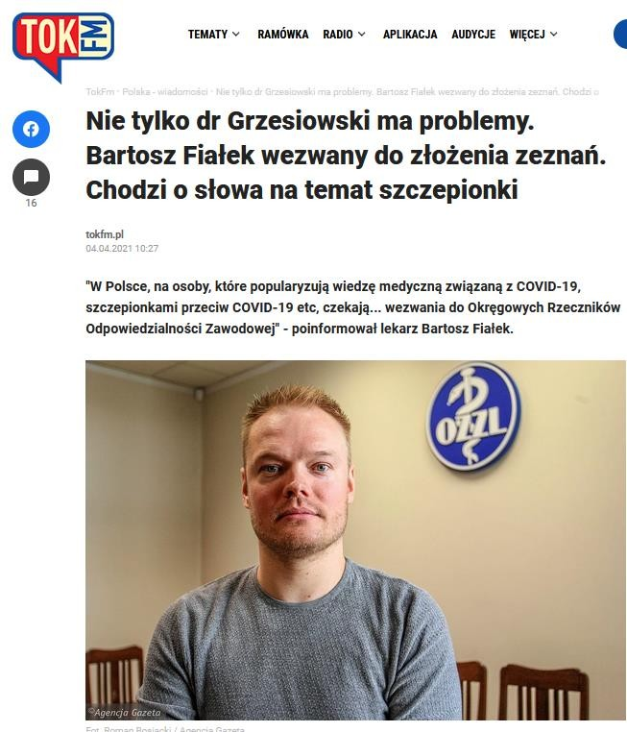
… complaint to Professional Liability Ombudsman…

Slide 37

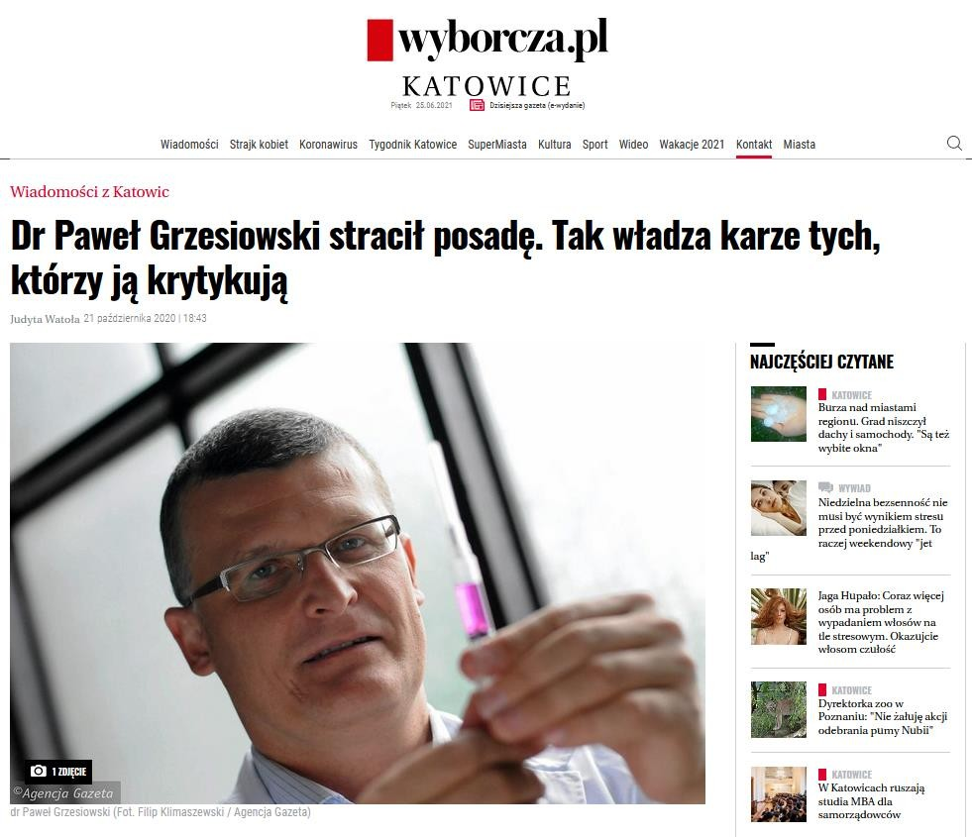
Fired from Postgraduate Medical Education Centre
… but designated by Suprem Medical Council as Chief Expert for COVID-19

Slide 38
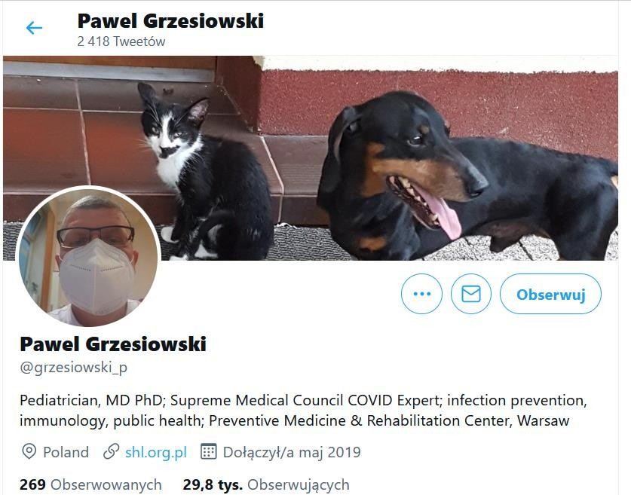
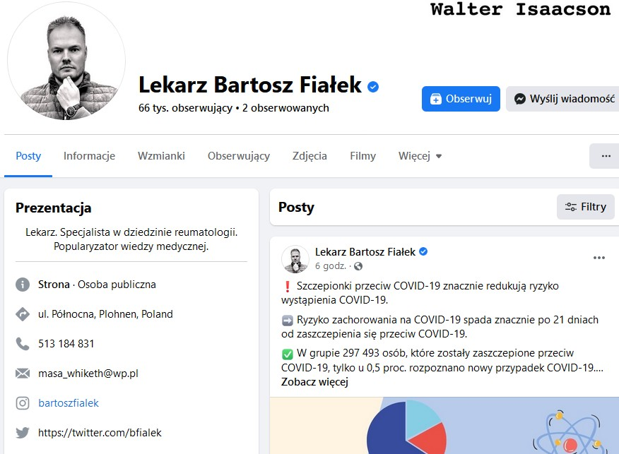

Slide 39
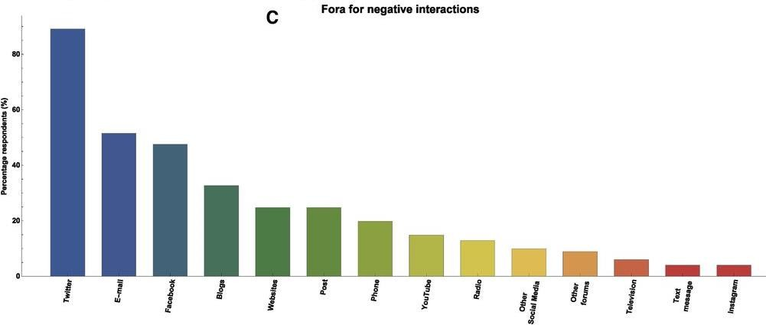
https://bmjopen.bmj.com/content/10/7/e035626

Slide 40
Conclusion:
Be prepared!

Slide 41
Find your place in that info-war:
On the front line?
-> Take your media training before!
As a suport?
-> Establish network – with journalist, influencers, youtubers…
Operation in cover?
-> yes, you have to create a fake account:p but you spy for right side of this warfare

Slide 42
What would really help?

Slide 43
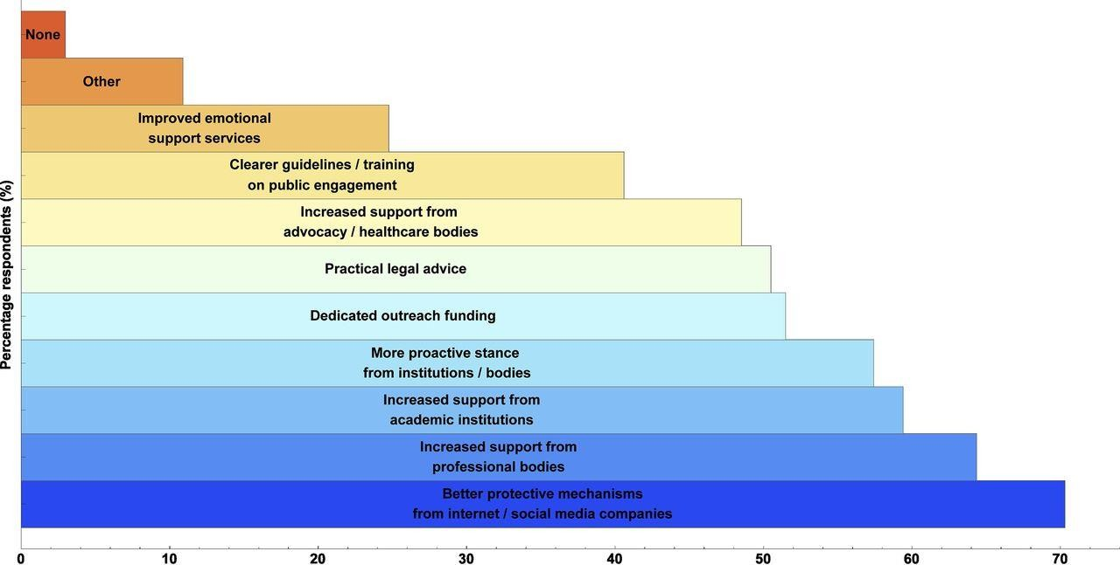
https://bmjopen.bmj.com/content/10/7/e035626

Slide 44
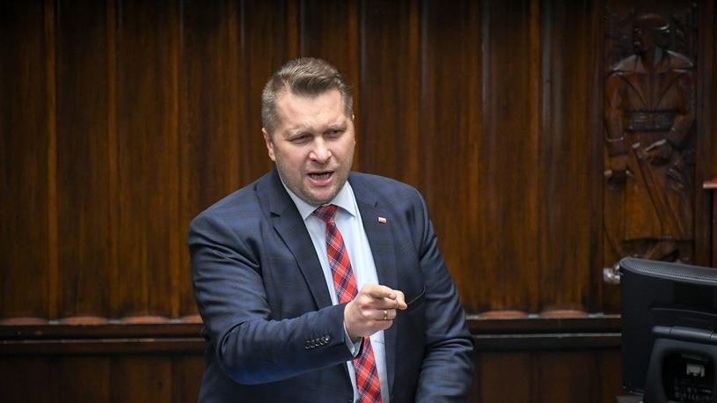
Spoiler:
Government is not always on your side!!!

Slide 45
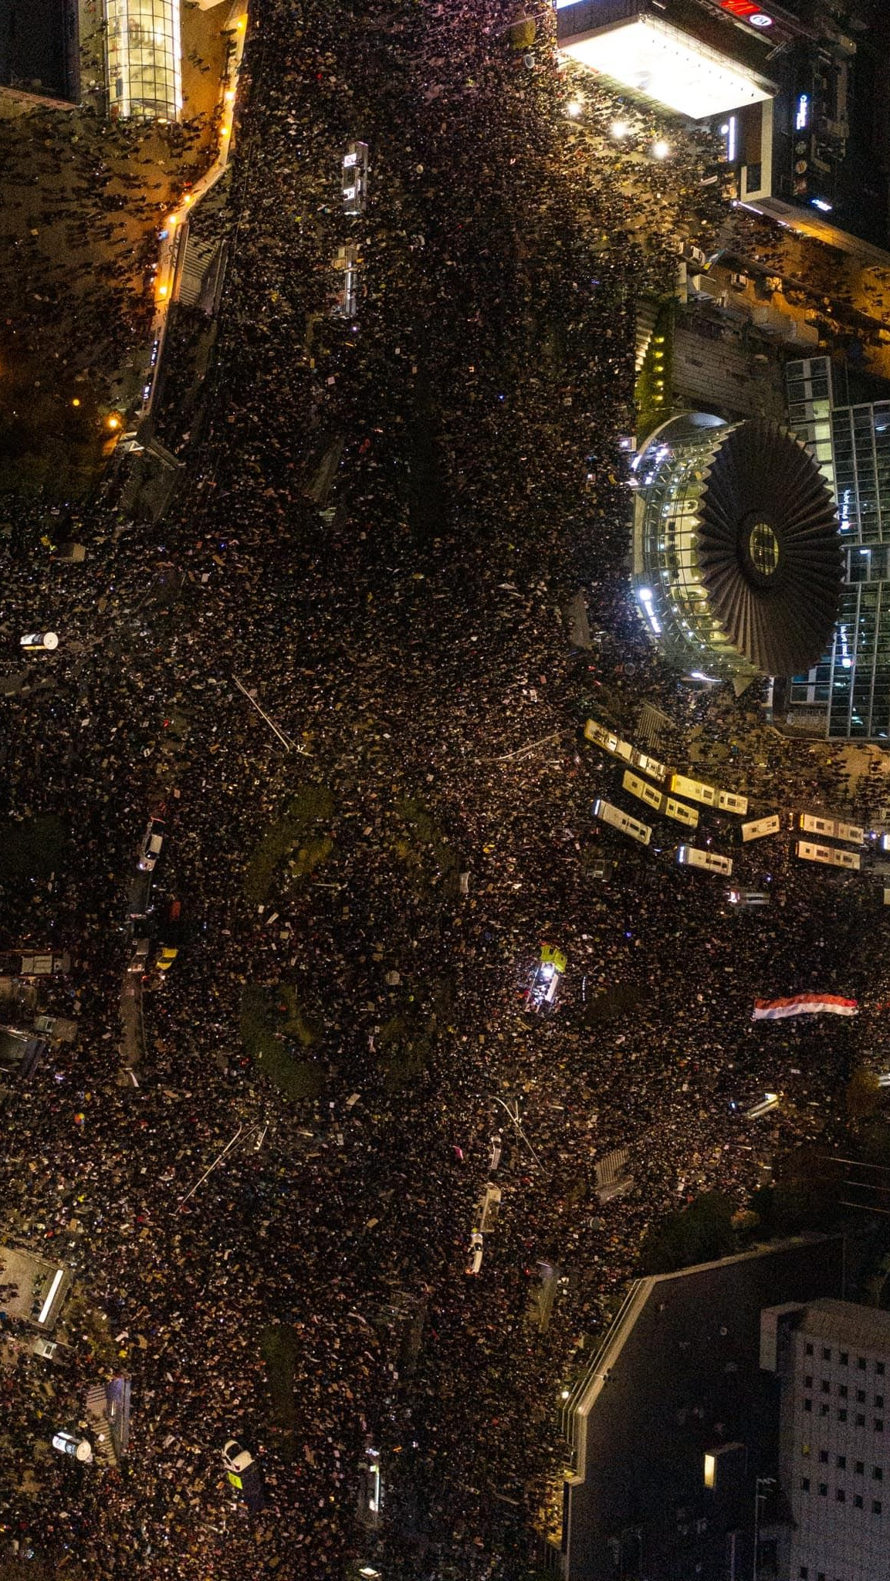
https://www.facebook.com/pg/bartstaszewski/photos/?ref=page_internal

Slide 46

Fired from Postgraduate Medical Education Centre
… but designated by Suprem Medical Council as Chief Expert for COVID-19

Slide 47
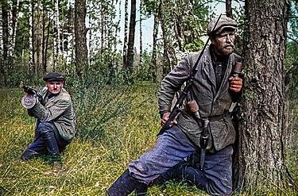
„Science Communication in civil society”
…partisan?

Slide 48
Being INDEPENDENT
Being PROTECTED by network
Opportunities?
Being EFFICIENT
Being INFLUENTIAL

Slide 49
Battlefield: social media!
Dariusz Aksamit
March for Science Foundation www.aksamit.info
AESIS Impact of Science 2021

Slide 50
Impact of Science
23-25 June, 2021
Marina Joubert
Senior Researcher, Stellenbosch University, South Africa
#IOS21

Slide 51
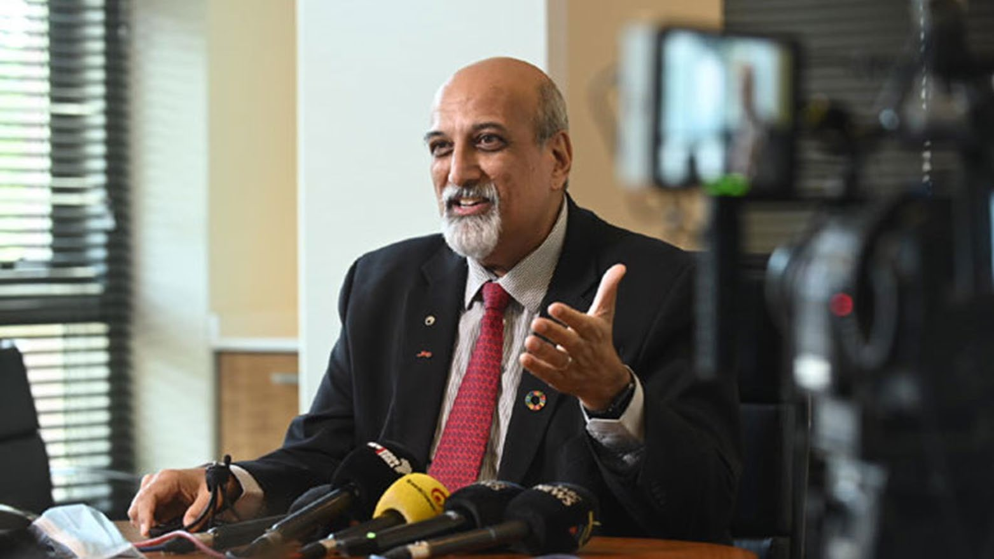
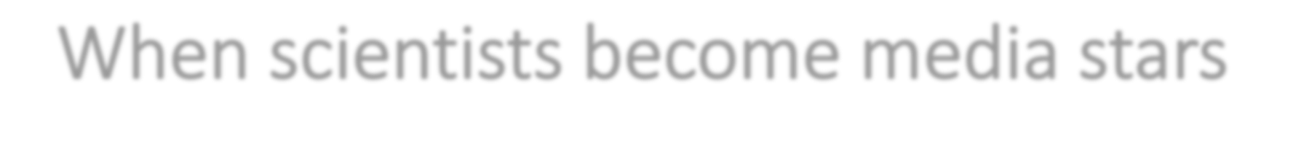

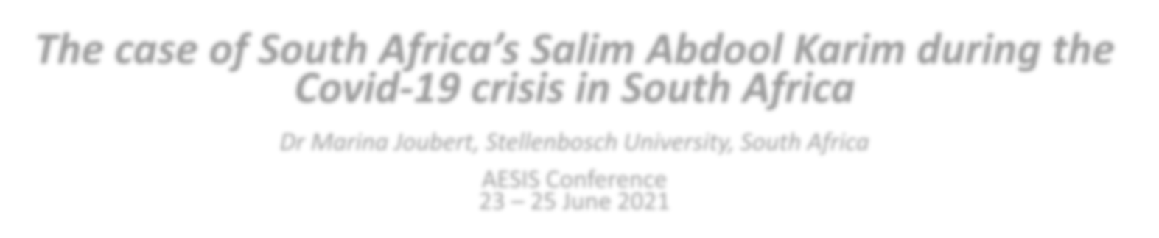

When scientists become media stars
The case of South Africa’s Salim Abdool Karim during the
Covid-19 crisis in South Africa
Dr Marina Joubert, Stellenbosch University, South Africa
AESIS Conference 23 – 25 June 2021

Slide 52
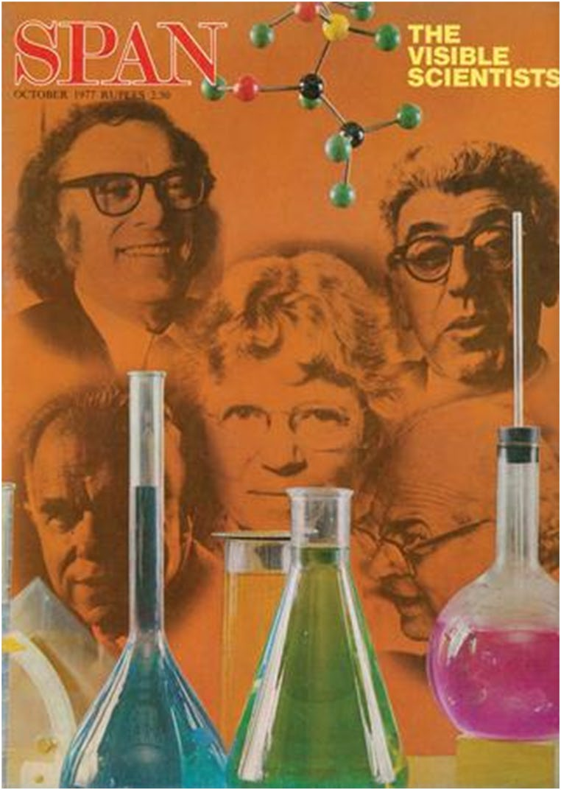
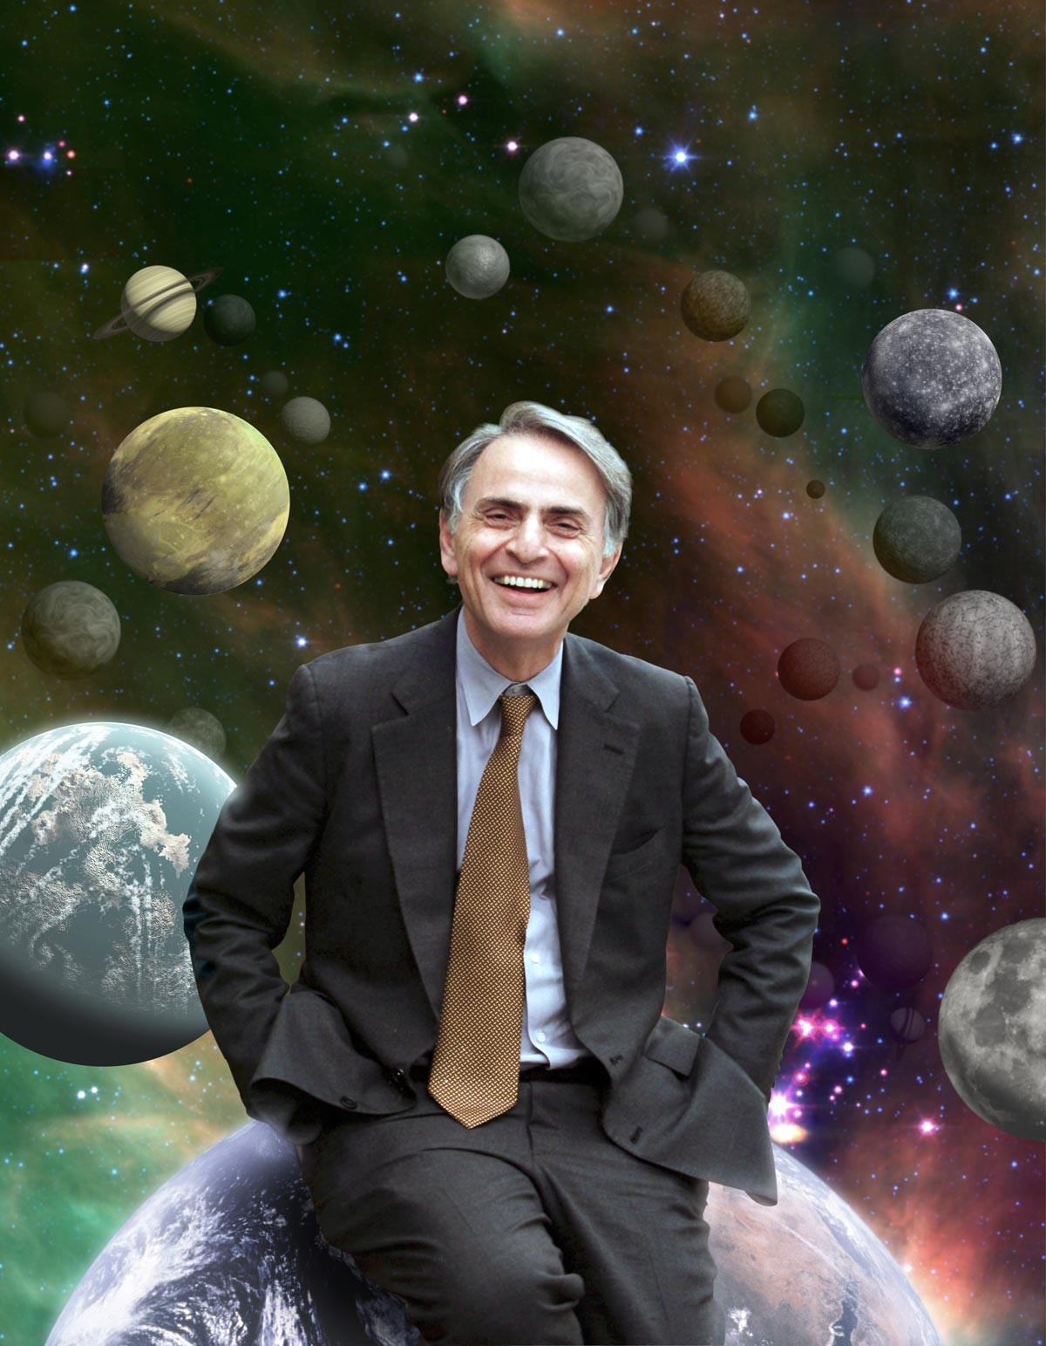

Slide 53
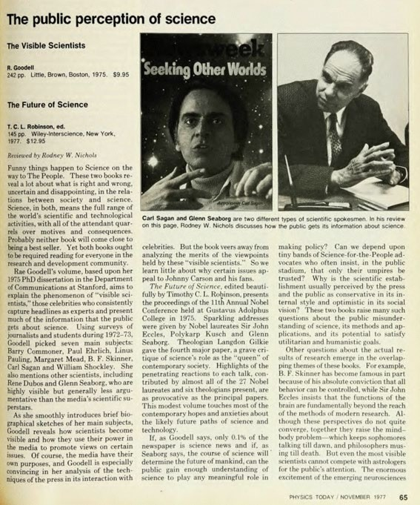
Visible scientists
hot topic
controversial
articulate
colourful image, appearance and personality
they touch the right chords with the public
competitive and ambitious
they enjoy credibility within science
understand the needs of the mass media; take advantage of media opportunities and typically develop strong relationships and sophistication in their dealings with journalists

Slide 54
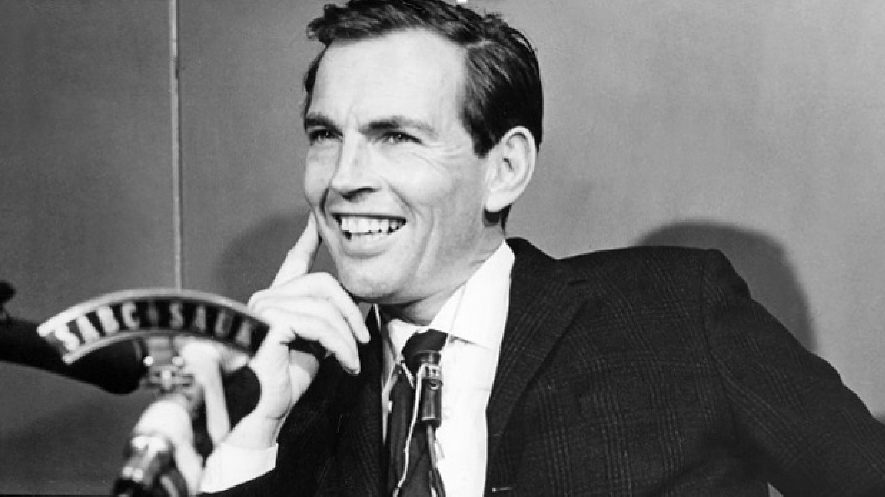
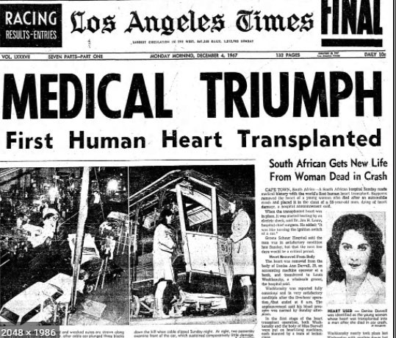
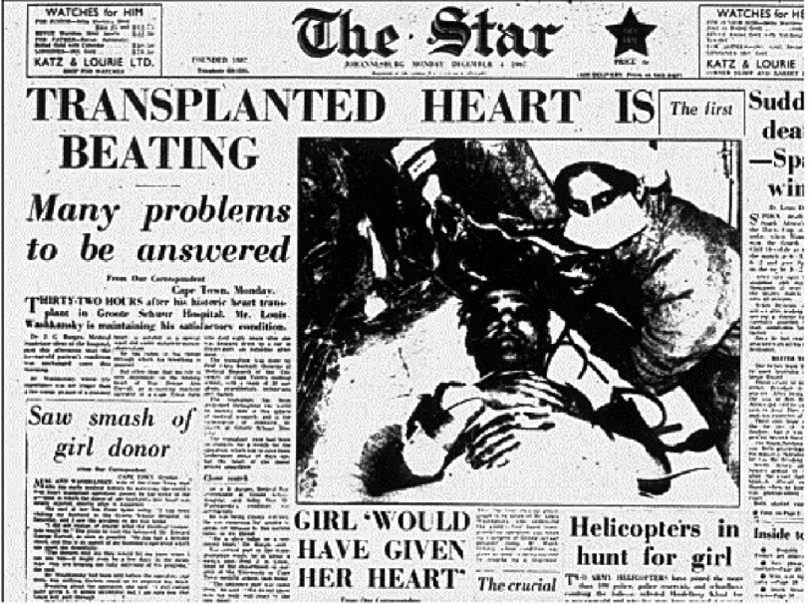

Slide 55
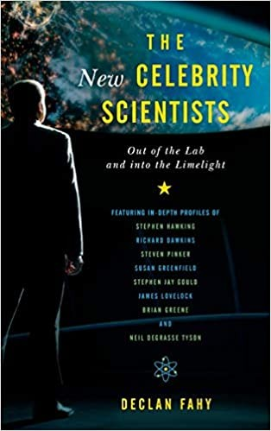
“stars that grip the public imagination”
“articulate, controversial, distinctive”
How they communicate
Topic tied to public issues
Interesting personalities
‘a compelling presence’ & ‘good looks’
2015

Slide 56
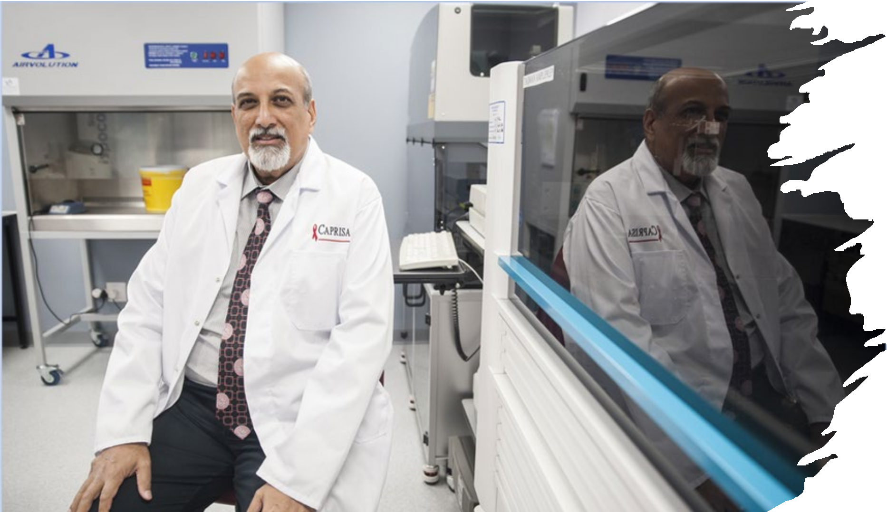

Slide 57
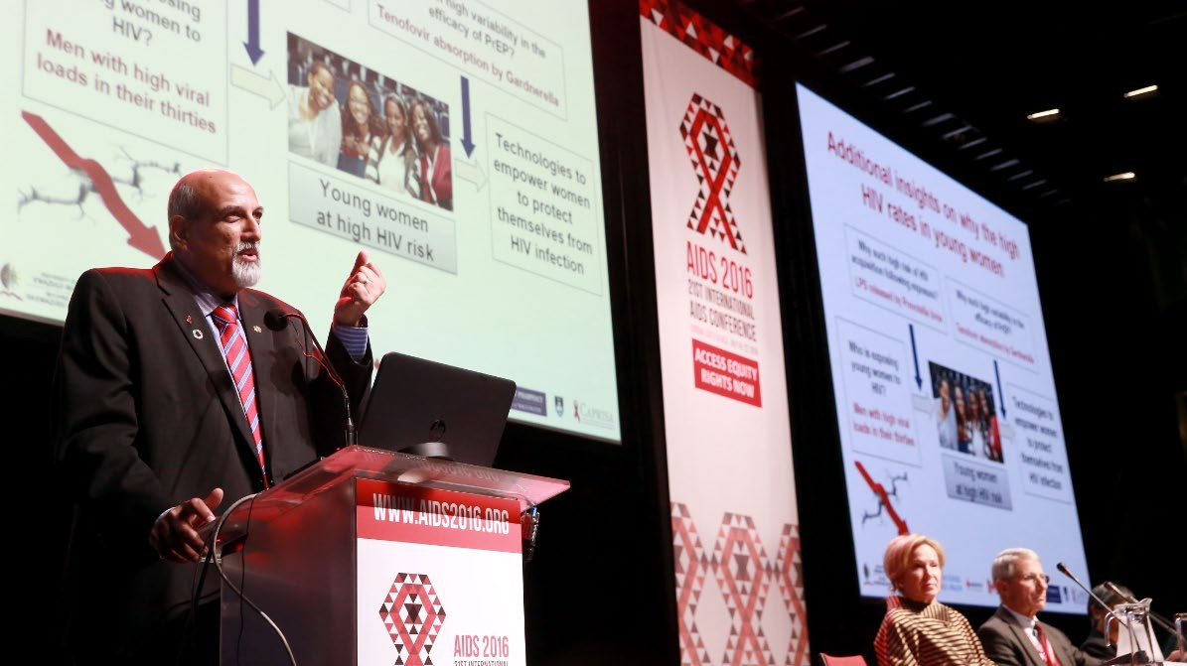

Slide 58
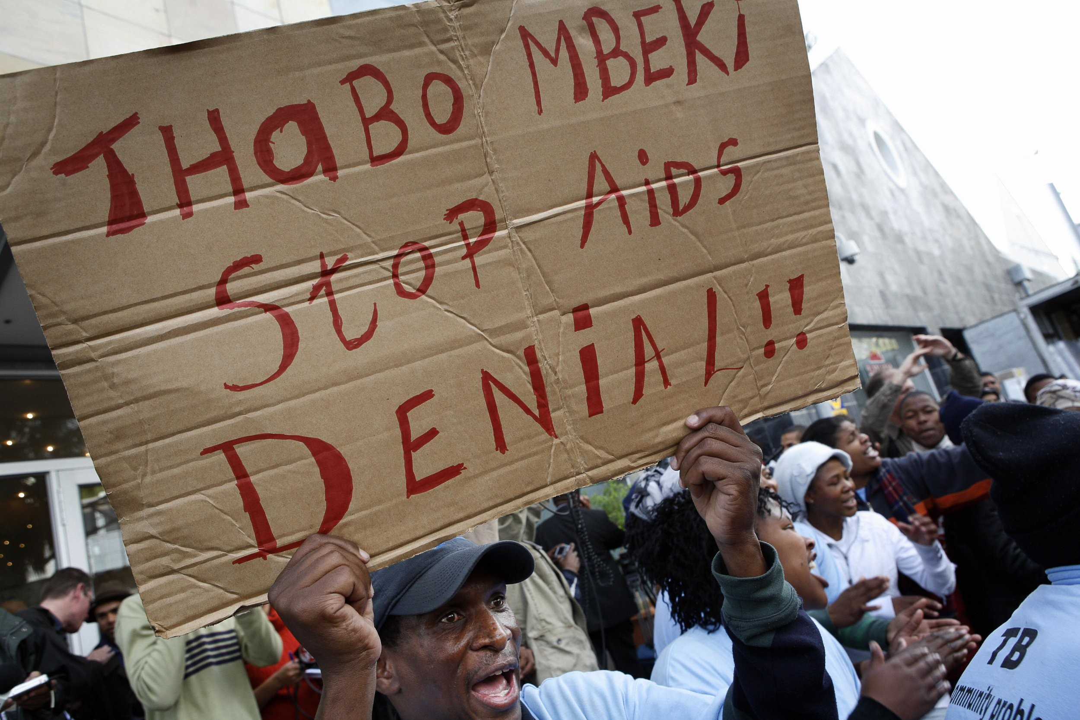

Slide 59
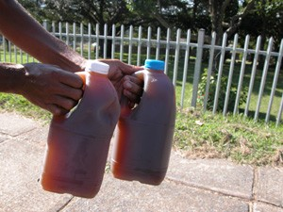

Slide 60
March for science, April 14, 2018 Durban, South Africa

Slide 61




Slide 62


Slide 63




Slide 64




Slide 65

#ProfKarim SA’s Covid-19 Hero!
This man gives SA peace in his explanations.
What a great resource to SA at this time!
#ProfKarim: World-class. Proudly South African!

Slide 66




Slide 67




Slide 68



Slide 69



Slide 70



Slide 71



Slide 72



Slide 73




Slide 74



Slide 75




Slide 76




Slide 77



Slide 78


Slide 79


Slide 80

Carlos Amato

Slide 81


Slide 82


Slide 83


Slide 84


Slide 85


Slide 86




Slide 87



Slide 88



Slide 89


Slide 90

marinajoubert@sun.ac.za
@marinajoubert

Slide 91
Impact of Science
23-25 June, 2021
Thank you
#IOS21

